Slide 1
EENG 385 Amplifier Measurements
Notes:
Usually the <title of the lab> is what will be called the “System” through the rest of this document

Slide 2
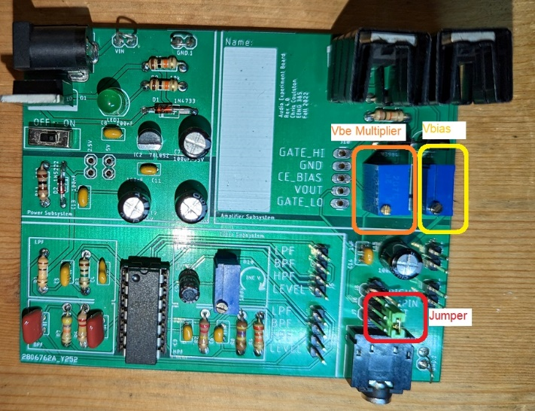
Lab Objectives
The objective of this lab is to configure, use, and analyze the audio amplifier on the Audio board and compare the results to the analysis performed last week.

Slide 3
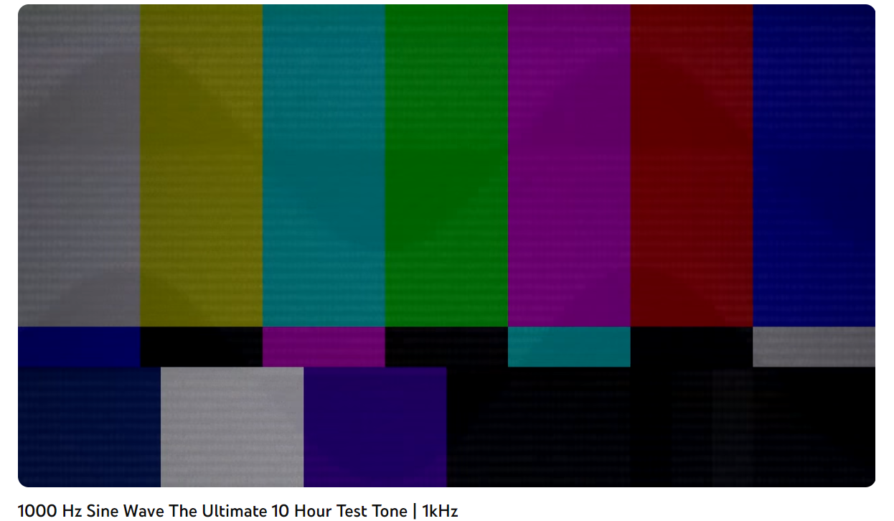
Setup Step 1 - initialization
Vbe Multiplier POT (left one)
Turn CW at least 20 turns. You may hear it click.
Vbias POT (right one)
Turn CCW at least 20 turns. You may hear it click it click.
Turn CW 4 turns
Install jumper
Configure oscilloscope
Connect 3.5mm audio cable to source
Connect Power Supply with 16V and 0.2A
Load YouTube
Notes:
Replace <System> with the name of the

Slide 4
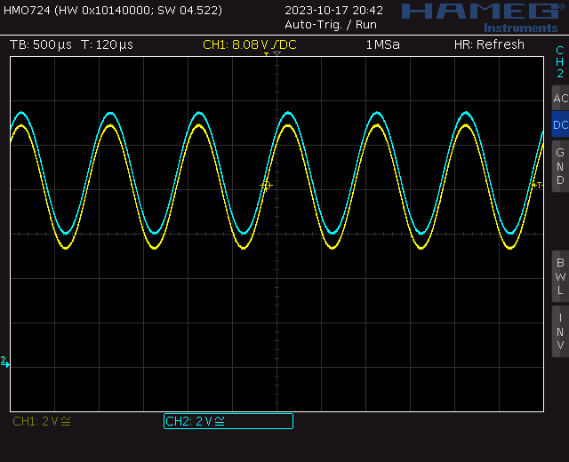
Setup Step 2 - Vbias
Adjust Vbias POT CW/CCW
Center waveforms to 8V
Notes:
Replace <System> with the name of the

Slide 5
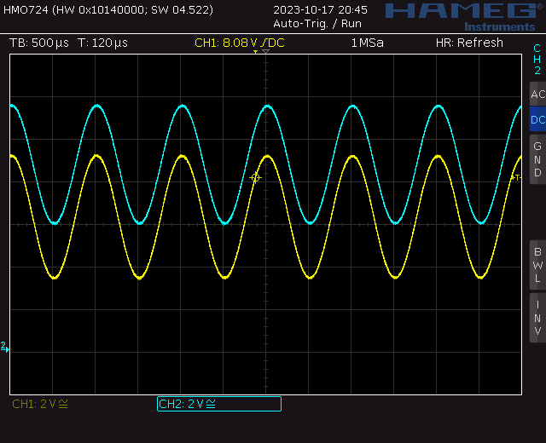
Setup Step 3 - Vbe
Adjust Vbe POT CCW
Separate waves by 2.4V
Just before current spikes
Notes:
Replace <System> with the name of the

Slide 6
Setup Step 4 - Vbias
Adjust Vbias POT CW/CCW
Re-center waveforms to 8V
Notes:
Replace <System> with the name of the

Slide 7
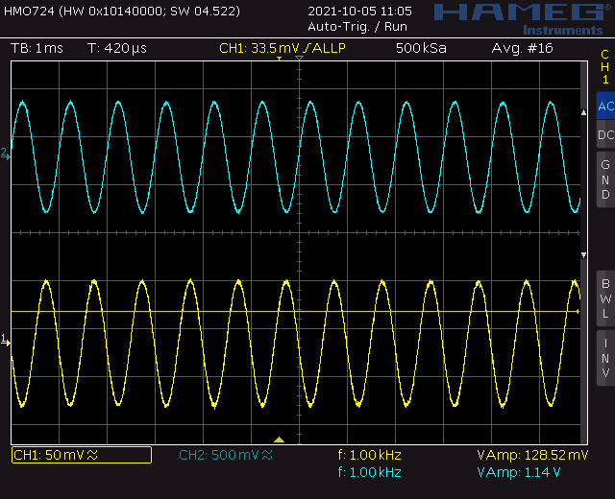
Test No Speaker Gain
Measure no speaker
Voltage from MP3 player (yellow)
Collector of first stage BJT (blue)
Relative amplitudes are what matters
Notes:
Replace <System> with the name of the

Slide 8
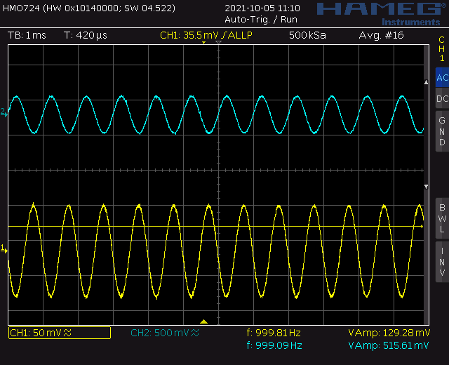
Test With Speaker Gain
Measure with speaker
Voltage from MP3 player (yellow)
Collector of first stage BJT (blue)
Relative amplitudes are what matters
Notes:
Replace <System> with the name of the

Slide 9
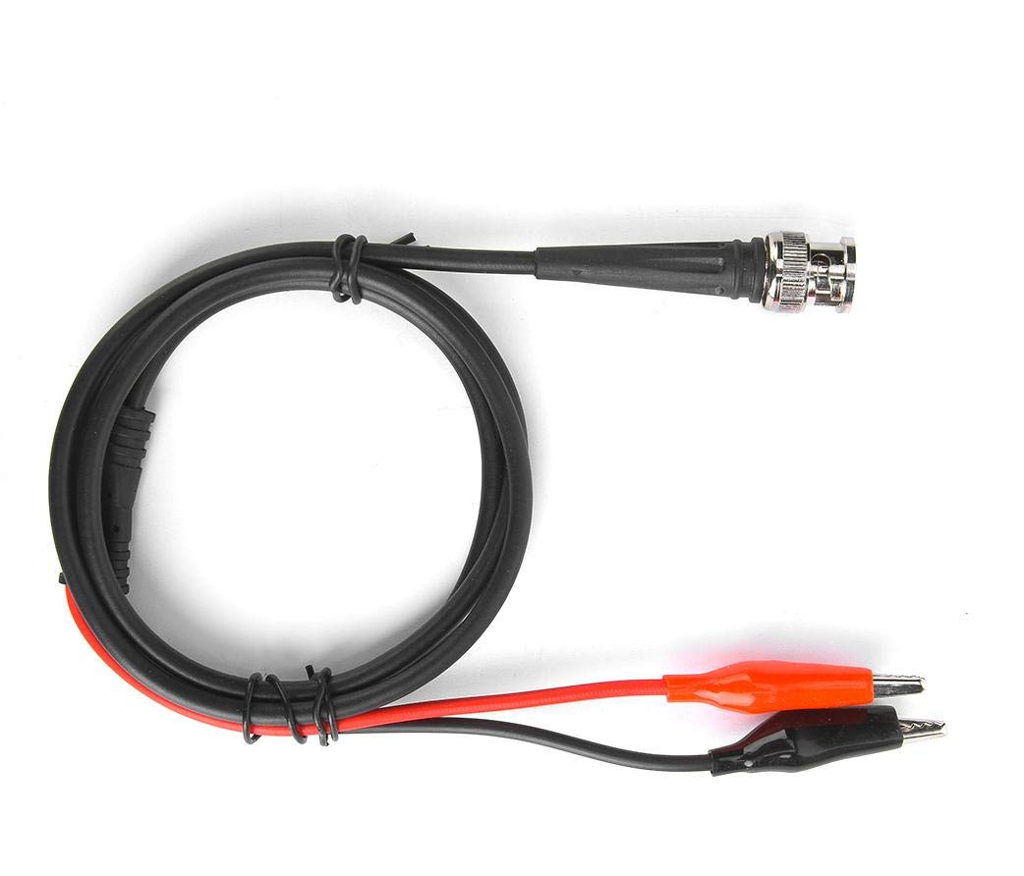
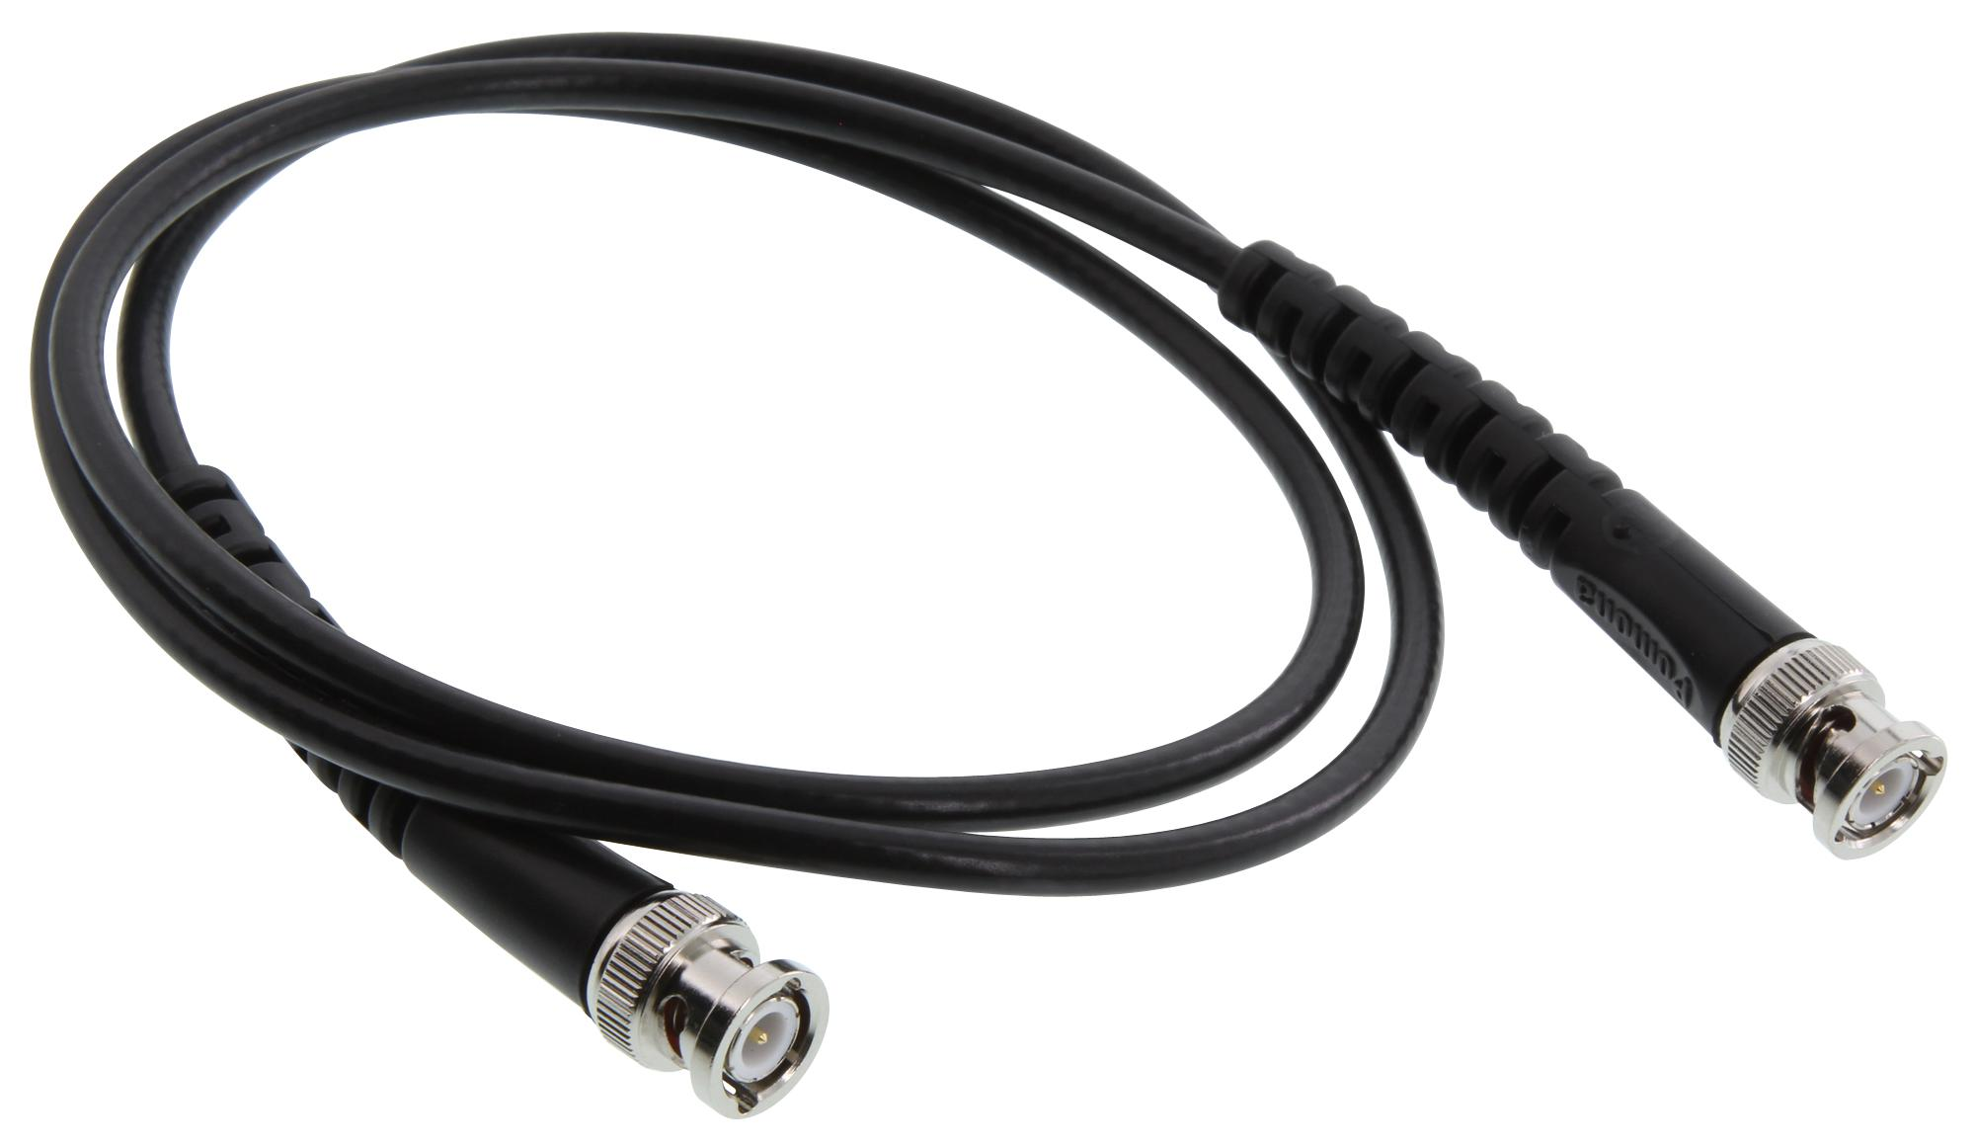
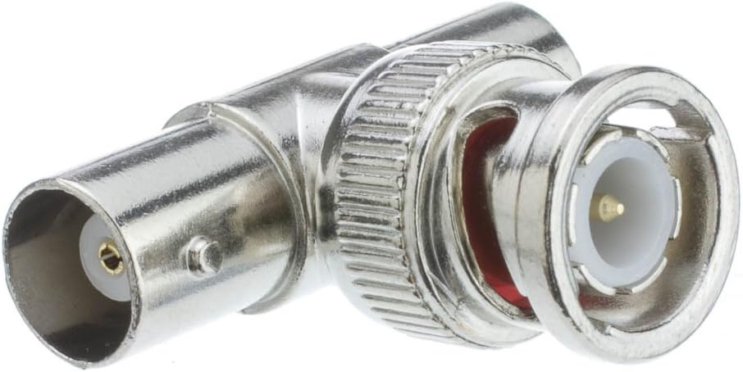
Bode Plot Pro Tip
Use BNC T-connector to send oscilloscope function output to
Oscilloscope Channel 1 using BNC to BNC cable
Circuit using function generator cable
T-connector BNC to BNC cable Function Gen Cable

Slide 10
Turn In
Amplifier Measurements
Screen shot of input and output with no-load
Calculation of no-load gain
Screen shot of input and output with 8Ω speaker
Calculation of 8Ω gain.
Bode plot of amplifier
Apply an Audio Source
Demo working amplifier by playing a song
Notes:
Replace <System> with the name of the

Slide 11
Have Fun
Components are safe up to 25V or so
Find a big speakers – give it a go!
Decrease emitter resistor for more gain
Things may get hot
Adjust Vbe POT as needed
I have heat sinks if needed
Use FLIR camera to keep an eye on things
Lick finger before touching suspect component Sizzle = hot
Smell for melting components

